Slide 1
Autothon 2019
Submitted by:
A++

Slide 2
Outline
Scope
Business Case
Types of testing
Deliverables
Defect Management
Acceptance Criteria
Risks and Mitigation
Test Automation and tools
Reporting

Slide 3
Scope
In Scope
Web application testing
Out Scope
Mobile application testing

Slide 4
Business Case
Customers – movie lovers
Engagement - legitimate access to the rich film database and the customized benefit
Delivery - It procures films clients need to watch and it utilizes the suggestion motor to make the administration customized and engaging.

Slide 5
Types of Testing
Functional – Smoke, Sanity, Regression
Automation – UI, API, Mobile
Usability - User experience, Ease of access
Performance – Load, Stress, Volume
Security - Secured Login, SQL injection, DoS Attack, Payment gateway testing

Slide 6
Deliverables
Regression suite
Automation Framework
Performance Framework

Slide 7
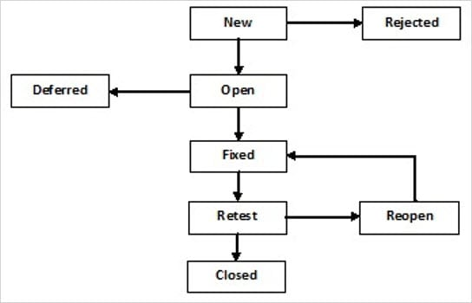
Defect Management
The defects will be logged in Defect management tool like Jira
Defect Lifecycle

Slide 8
Acceptance Criteria
Business Analysts to review Acceptance Criteria
Stakeholders to signoff the final build after QA go ahead

Slide 9
Risks And Mitigation
Risks
Security Challenges
User account safety
Corruption of database by external means
Damaging of the rented disc
Non return of disc by user
Mitigation
Advance rental
Checking the disc after return

Slide 10
Test Automation and Tools
UI – Java + Selenium
API – Postman
Mobile - Appium

Slide 11
Reporting
Defect Density
Defect leakage
Defect removal efficiency
Review effectiveness
Rework
Effort variance
Schedule variance
Test efficiency
Defect validity ratio
Defect slippage

Slide 12
THANK YOU

